Slide 1
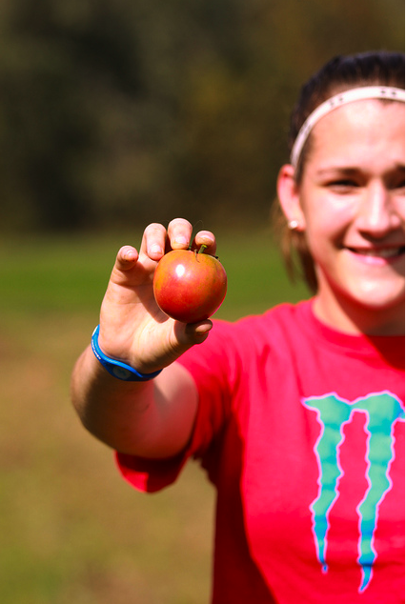
Homegrown Kentucky
Luke McAnally
Patrick Johnson

Slide 2
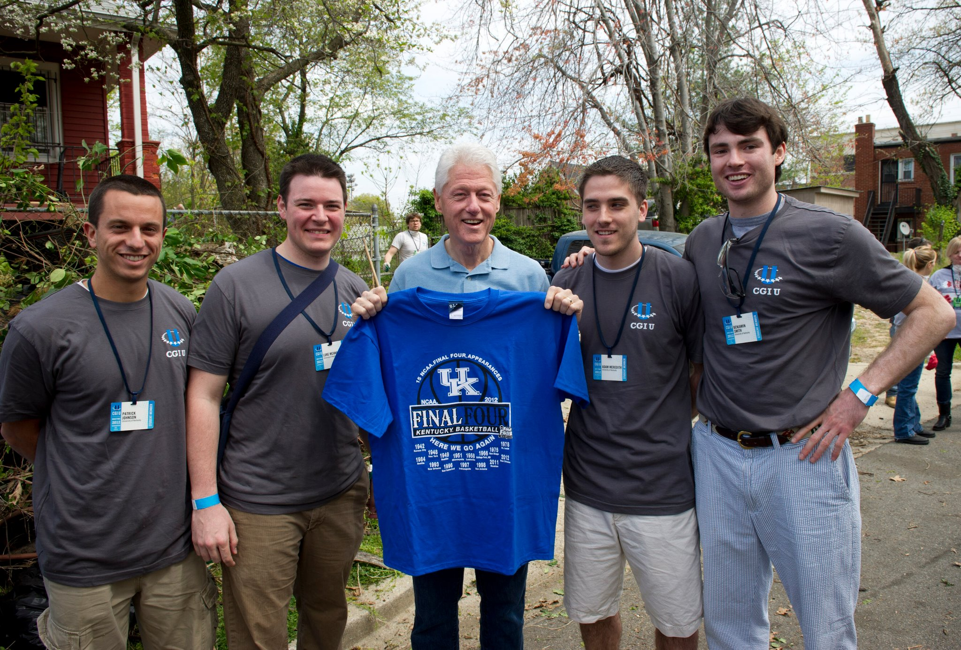

Slide 3
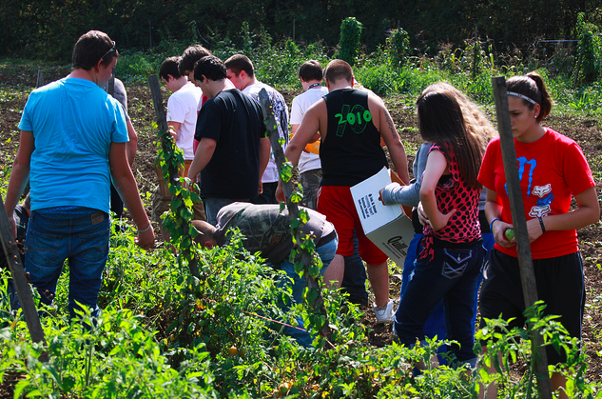
Typically one of the top 5 poorest counties in the United States.
Land Available Next to School
Proximity to Breathitt County’s pre-existing resources.
Owsley County

Slide 4
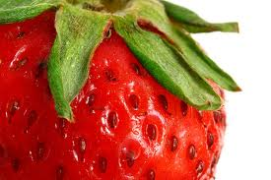
Approach
Specific framework for the community.
Create a unique program.
Measurable.
Sustainable.

Slide 5

Identify Community Members
Superintendant
Soil Conservation
County Extension
Ag Teacher
Food Service Director
Influential Community Members

Slide 6
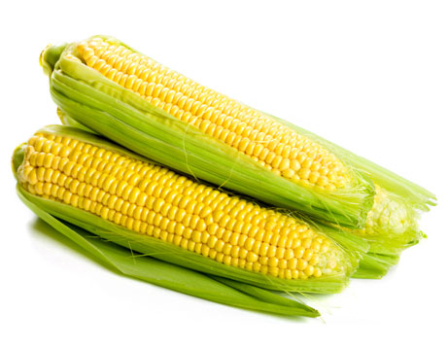
Project Idea
Cultivation-to-Plate
Use Produce in School Cafeteria
Opportunity to Sell in Local Farmer’s Market
Integrate into School Curriculum

Slide 7
Cultivation to Plate
Student’s learn about full life cycle of produce:
  Tillage
  Planting
  Nurturing
  Harvesting
  Marketing
  Processing
  Preparing

Slide 8
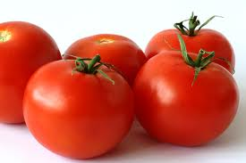
Produce in Cafeteria
“How many students eat fresh produce in their home?”
~Ag Teacher
Now students are producing their own food.
Source of Pride.

Slide 9
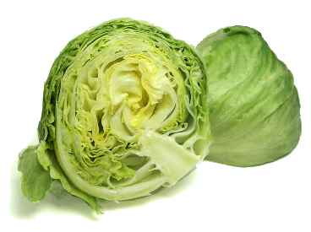
Local Farmer’s Market
Local citizens have opportunity to have plot on school grounds.
Seeds and equipment provided.
Farmer’s Market sells out very early.

Slide 10
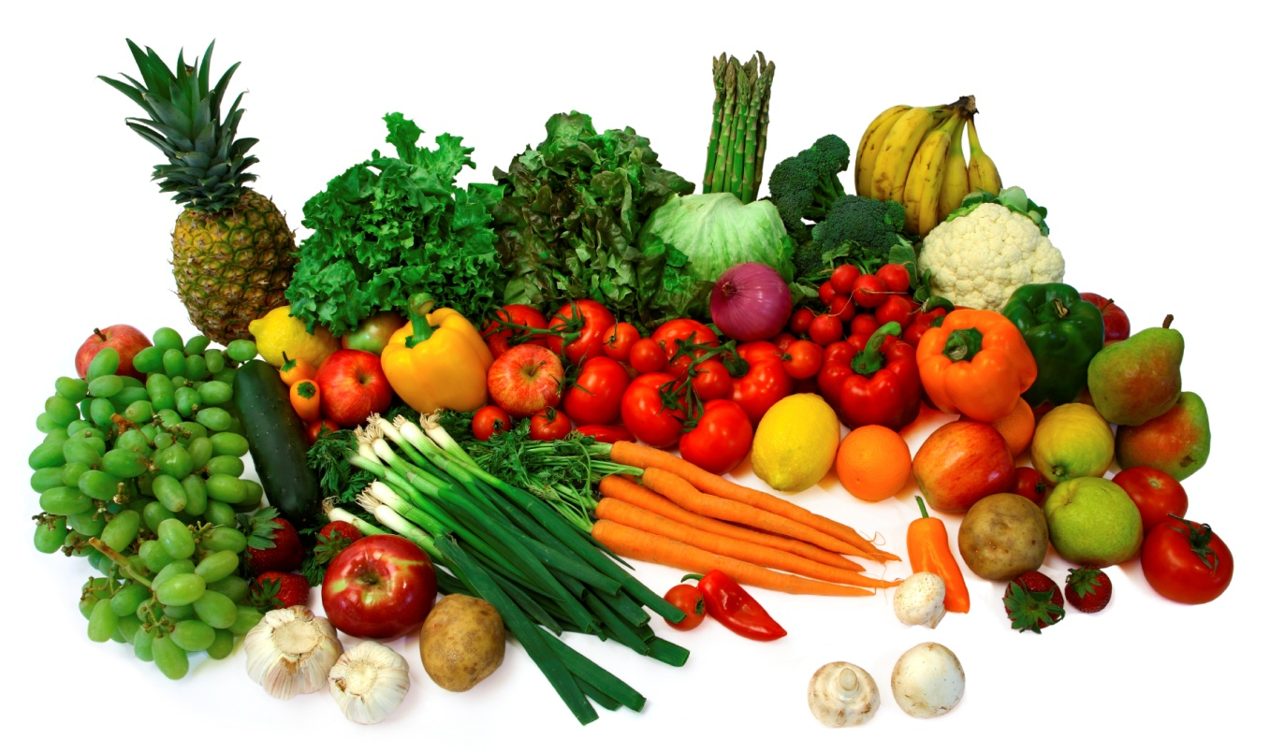
School Curriculum
Students are excited about school.
Pride in work that they have produced.

Slide 11
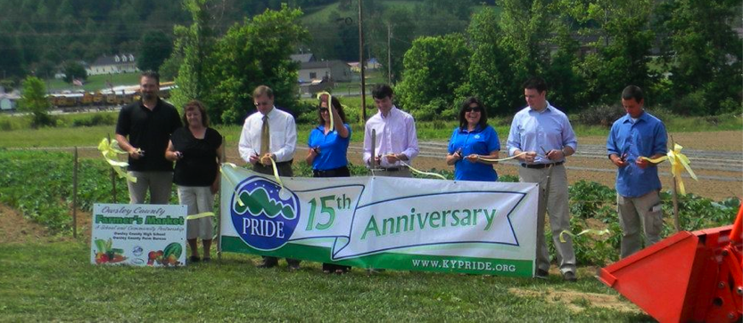
Project Impact

Slide 12
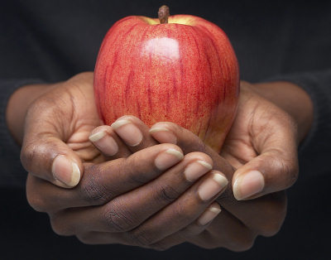
Health Impact
Citizens have access to fresh food in ‘food desert’.
Students are more physically active.

Slide 13
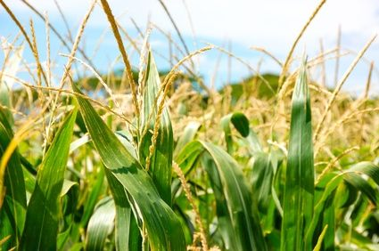
Economic Impact
Individuals have opportunity to have supplementary income through farmer’s market.
Students have skills to work immediately following graduation.

Slide 14
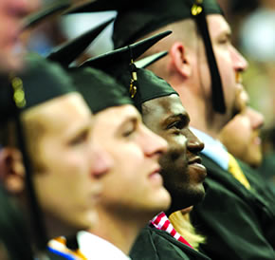
Educational Impact
Students have reason to come to school.
Pride in work that they are doing.
Higher probability they will remain in school.

Slide 15
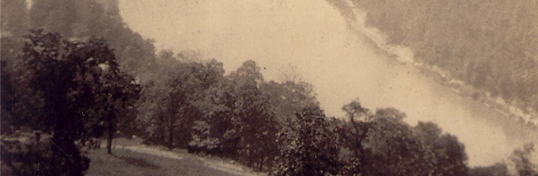
Environmental Impact
Cut down on food transportation costs.
Provide jobs for young people that do not involve destructive industries.

Slide 16
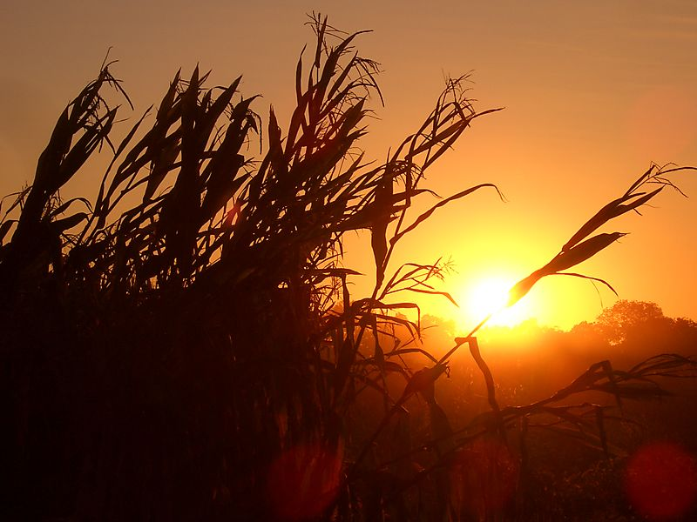
Going Forward
Owsley Co. is virtually self-sustaining.
$25,000 grant received.
Applied for
$100,000 USDA grant.

Slide 17
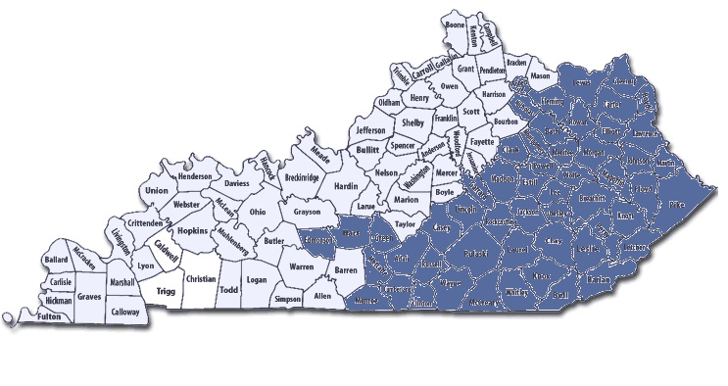
Expansion to New Community
Homegrown Kentucky is looking to expand to another community in the region with similar needs.

Slide 18
Questions?
Contact Information
Luke McAnally
luke.mcanally@uky.edu
Patrick Johnson
pbjo222@g.uky.edu
Jessica Gambrel
jaga226@g.uky.edu
www.homegrownkentucky.org

