Slide 1





Unbridled Learning
Delivery Plans Strategies

Slide 2





Goals -- Student Outcomes
Delivery
Project Management
KDE Work
programs projects processes
Strategic Plan
What are we
trying to do?
How are
we trying
to do it?
At any given
moment, how
do we know we
are on track?
What are we going to do if we are not
on track?

Slide 3

The delivery approach produces results by focusing leaders on four fundamental questions
“delivery” (n.) is a systematic process through which system leaders can drive progress and deliver results.
It involves asking the following questions consistently and rigorously:
1
What are we trying to do?
2
How are we planning to do it?
3
At any given moment, how will we know whether we are on track?
4
If not, what are we going to do about it?

Slide 4




Delivery in a nutshell
1
2
3
4
Develop a foundation for delivery
Understand the delivery challenge
Plan for delivery
Drive delivery
Helps agency become clear on what it is trying to do for its students
Helps agency understand where students are today and why
Helps agency explicitly connect its work to goals for students
  Determine your reform strategy
  Set targets and establish trajectories
  Produce delivery plans
Helps agency remain focused on its priorities
  Define your aspiration
  Review the current state of delivery
  Build the delivery unit
  Establish a “guiding coalition”
  Evaluate past and present performance
  Understand drivers of performance and relevant activities
  Establish routines to drive and monitor performance
  Solve problems early and rigorously
  Sustain and continually build momentum
5
Create an irreversible delivery culture
A. Build system capacity all the time
B. Communicate the delivery message
C. Unleash the “alchemy of relationships”
Helps stakeholders inside and outside of the agency understand the work underway and how they connect to it

Slide 5
We believe that a committed leadership team using these tools will achieve significant results for students.
Bold, committed leadership with strong aspirations
Relentless pursuit of answers to four questions by a small group within the agency
Rigorous and consistent application of 15 elements across the agency
Results for Students

Slide 6

Developing the Delivery Plans
Three specific actions are
taken in developing the
Delivery Plans.
1. Reform Strategy
Delivery Plans
2. Delivery Chains
3 .Trajectories
6
Notes:
So once we understand the 15 components of Delivery, then we use that knowledge to develop the Delivery Plan.
This requires three specific actions:
defining reform strategies
developing the Delivery Chain for each strategy and
determining the strategy level trajectories and the overall goal trajectory.

Slide 7
College-/Career-Readiness Goals
GOALS
Increase the percentage of students who are college- and career-ready from 34% (16,320 students) to 67% (32,160 students) by 2015.
Increase the Averaged Freshman Graduation Rate from 76% (36,480 students) to 90% (43,200 students) by 2015.
7
Notes:
Graduation Goal was set by federal requirements.
CCR Goal was set by SB1.
CCR Formula: 100-34=66 divide 66 in half to improve by 50% (66/2=33) add that half to the baseline to set goal (34+33=67)

Slide 8

College-/Career-Readiness
Strategies
Persistence to Graduation
Course and Assessment Alignment
Unbridled Learning
Accountability Model
Targeted Interventions
Career Readiness Pathways
Acceleration (AdvanceKY, Project Lead the Way, Early College Designs)
Academic and Career Advising
Priority Schools
8
Notes:
(Ken will speak to accountability model.)
KDE requires all districts to implement Targeted Interventions for students who do not meet CPE system-wide benchmarks on the ACT in math, reading and English.

Slide 9
College-/Career-Ready Trajectory
9

Slide 10
CCR - Targeted Interventions
Estill County
Notes:
Estill County used SIG money to focus on Targeted Interventions. Here we see evidence of successful implementation of Targeted Interventions.
In 2009-10, 33% of 11th graders met benchmarks on all three components of the ACT (i.e., 33% college readiness).
In 2010-11, 48% of 12th graders met college placement benchmarks, thus increasing Estill’s college readiness rate by 15%.

Slide 11
Graduation Trajectory
89.7%
85.8%
81.9%
78%
76.3%
11

Slide 12
Proficiency Goals
GOALS
Increase the average combined reading and math K-PREP percent of proficient and higher for elementary and middle school students from ___% in 2012 to ___% in 2017.
Increase the number of students that will be ready for kindergarten by 50% in 2015-16 based upon 2012-13 baseline results.
Increase the average 3rd-grade math and reading combined K-PREP percent of proficient and higher to 90% by 2016, based on the results from the 2012 K-PREP test administration.
Increase the percentage of proficient and distinguished programs in arts and humanities, practical living/career studies and writing from ___% in 2012 to ___% in 2017 as measured on Program Reviews.
12

Slide 13


Proficiency Strategies
Curriculum, Assessment and Alignment
Continuous
Instructional Improvement
Technology System (CIITS)
Unbridled Learning
Accountability Model
Kentucky System of Intervention/
Response to Intervention (KSI/RtI)
Program Reviews
Literacy Initiative
Math Initiative
School Readiness and Early Learning
13

Slide 14


Gap
GOAL
Increase achievement for all student groups in Kentucky so that the achievement gap decreases from ___% in 2012 to ___% in 2017 as measured by school report cards.
14

Slide 15

Gap Strategies
Consolidated Planning, Funding/Flexibility
Alternative
Individual Learning Plans
Digital Learning
Professional Development
Progress Monitoring
Intentional Use of
Proficiency Strategies
for Student Demographic Groups
Extended Instructional Time
Focus Schools
Best Practices Network
15

Slide 16
How It Works
Planning
Delivery Plan
Goals
Strategies
Targets
Project
Management
Co – Pilot
Activities
Milestones
Budget
Progress
Monitoring
Assessment
Technical
Operational
Cultural
Progress
Monitoring
KDE
Strategies
Milestones
Budget
Targets
Data
KBE Goals
CCR
Graduation
Proficiency
Gap
Effective Teachers
Effective Principals
Strategies
Planning
ASSIST
Goals
Strategies
Targets
Project
Management
ASSIST
Activities
Budget
CDIP/CSIP
Technical
Operational
Cultural
Progress
Monitoring
Strategies
Activities
Budget
Targets
Data
DISTRICTS

Slide 17

Next-Generation Professionals
GOALS
Increase teacher effectiveness rate from ____% in 2015 to ___% in 2020.
Increase principal effectiveness rate from ____% in 2015 to ___% in 2020.
17

Slide 18

Next-Generation Professionals
Strategies
Professional Learning and Support
Collection and Use of Data: TELL Kentucky Survey
Human Capital Management & Development
Professional Growth & Effectiveness System
18

Slide 19

Timeline for Assessment and Accountability Reporting
Schools and districts will have an opportunity to review student accountability and demographics data before public reporting. All dates below are tentative.
    July 30 – Aug. 8 K-PREP/Alternate K-PREP grades 3-8
    August 20 – 29 High school clean-up (EOC & writing at grades 10 and 11; ACT grade 11 2012; Alternate)
    August 22 - 29 College and Career Readiness measures for
    graduates
Data are planned for release to schools and districts in late September/early October; public release in mid-October.

Slide 20
Calendar of “anchor” delivery routines for Kentucky
Stocktake
Bi-monthly note
Goals
Jan
Feb
Mar
Apr
May
Jun
Jul
Aug
Sep
Oct
Nov
Dec
College and career readiness
Proficiency
Gap
Next Generation Professionals
Notes:
This calendar shows the schedule of routines as they appear to the Commissioner.
We have stocktakes every 6 months, where the goal leader presents to the Commissioner on:
Progress on the goal
Areas of challenge
What issues exist
How we are dealing with them
Where we need help
We send notes via email every 2 months to show progress, areas of challenge, how we’re dealing with them, and where we need help from the Delivery Unit’s perspective.

Slide 21
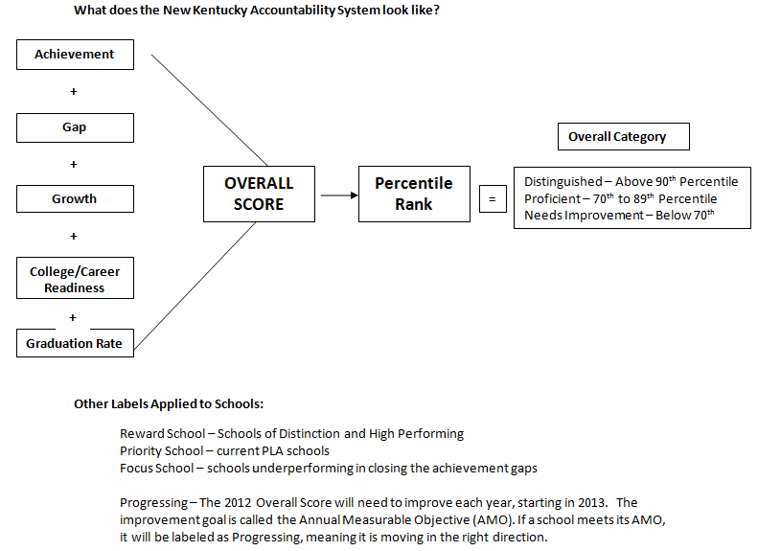
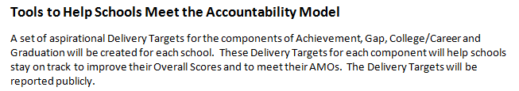

Slide 22
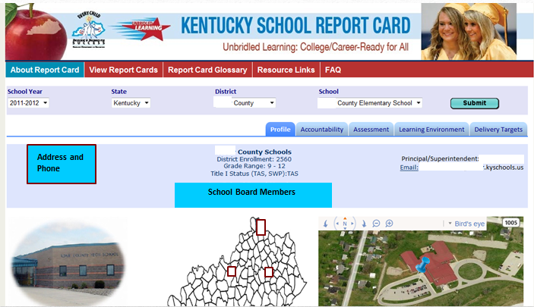

Slide 23

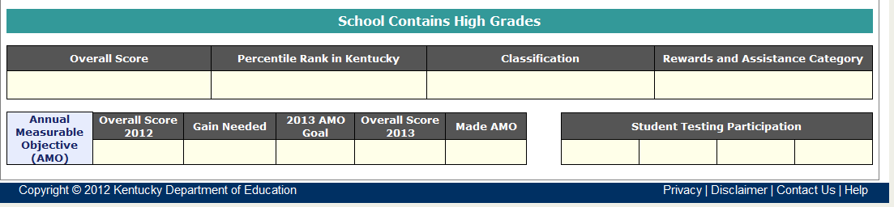
57.9
71
Proficient
57.9
3.0
60.9
YES

Slide 24
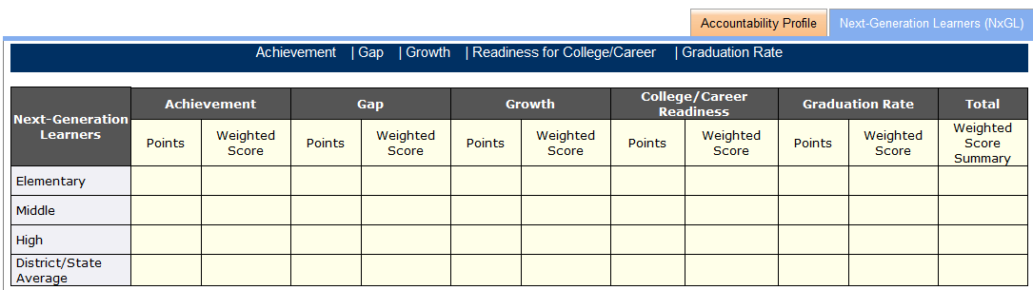
69.0 13.8 25 5 50.5 10.1 64 12.8 81 16.2 57.9
Weighted Score comes from Achievement, Gap, Growth, College/Career Readiness and Graduation Points multiplied by the weights in the chart. Weighted Score Summary comes from adding the Weighted Scores for each area.
Grade Range | Achieve-ment | Gap | Growth | College/ Career | Grad Rate | Total
Elem | 30 | 30 | 40 |  |  | 100
Middle | 28 | 28 | 28 | 16 |  | 100
High | 20 | 20 | 20 | 20 | 20 | 100

Slide 25
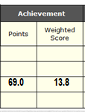
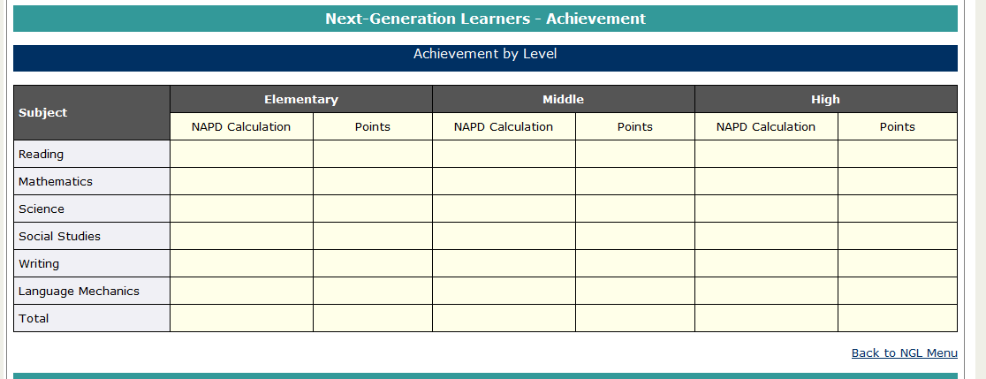
65 13
60 12
90 18
65 13
65 10.4
65 2.6
69
NAPD Calculation comes from the formula: Novice = 0; Apprentice = .5; Proficient/Distinguished = 1 (Bonus of .5 is added if there are more distinguished than novice).
Points come from the NAPD Calculation multiplied by the equal weight of content areas: Reading, Mathematics, Science, Social Studies are 20% and Writing/Language Mechanics is 20% (Writing 16% and Language Mechanics 4%).

Slide 26
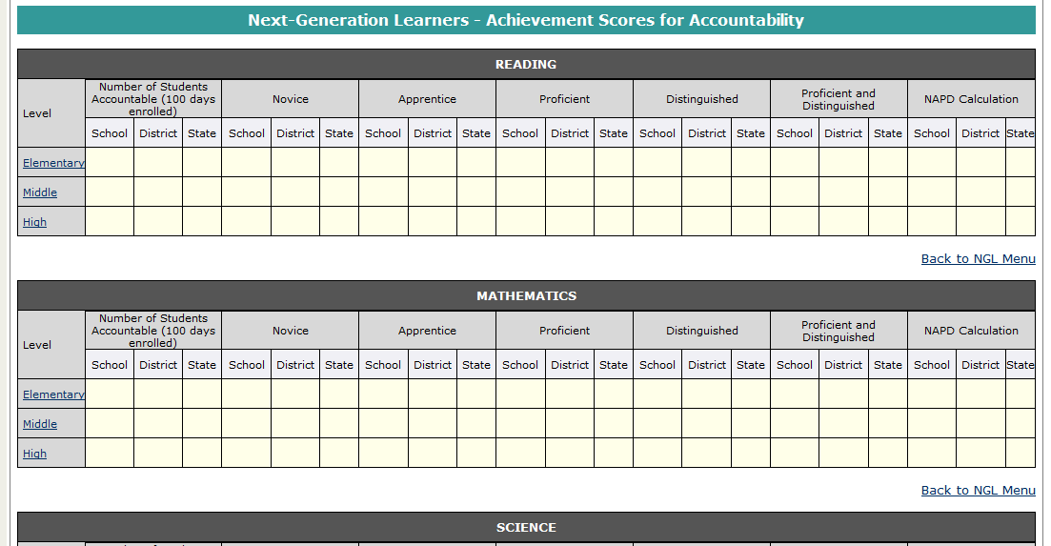
110
20
30
40
10
50
65
104
15
50
30
5
35
60
NAPD Calculation comes from the formula: Novice = 0; Apprentice = .5; Proficient/Distinguished = 1. (Bonus of .5, if distinguished is more than novice).

Slide 27
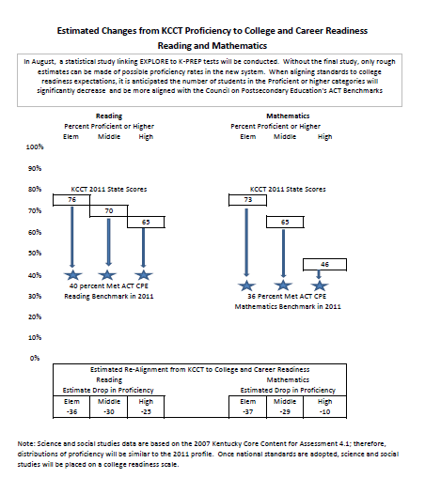

Slide 28
CCR Delivery Plan Status Report
Project | Executive Sponsor | Project Manager | Start Date | End Date | Schedule | Budget | Scope | Delivery
Acceleration - AdvanceKY | Smith, Felicia | Patterson, Amy | 10/1/2008 | 10/1/2008
Academic & Career Advising | Smith, Felicia | Johnston, Sharon | 1/1/2011 | 1/2/2012
Targeted Interventions | Smith, Felicia | Pieper, April | 3/20/2010 | 11/1/2012

Slide 29
Contact
Karen Dodd, PMP
Director of Strategic Planning
Kentucky Department of Education
500 Mero Street, 1st Floor
Frankfort KY 40601
(502) 564-4201
karen.dodd@education.ky.gov

