Slide 1
Standards Update:
Science and
Social Studies
Kentucky Board of Education
August 9, 2012

Slide 2
SB 1 Requirements
Focus on critical knowledge, skills, and capacities
Result in fewer, but more in-depth standards
Communicate expectations more clearly and concisely
Be based on evidence-based research
Consider international benchmarks
Ensure that the standards are aligned P-20
Notes:
Framework internationally benchmarked against 10 high performing countries
College and Career Readiness alignment ongoing
Emphasis on the practices and skills of science through the integration of Scientific & Engineering Practices and Cross Cutting Concepts (higher and clearer)
Driven by feedback from the 26 Lead States
Content vetted by the National Academy of Sciences
Disciplinary Core Ideas: foundational content with broad explanatory power
13 Disciplinary Core Ideas incorporated in 62 standards (deep rather than wide)

Slide 3
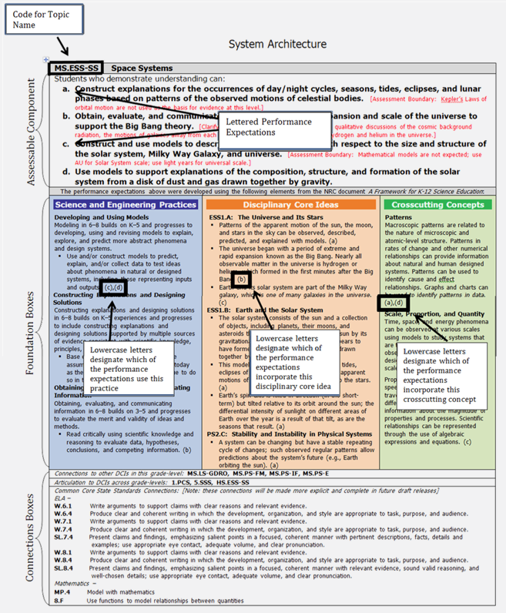
NGSS Structure (draft)
62 Total standards
Draft version was arranged K,1,2,3,4,5, MS, HS
Final version will be available in grade level and grade band configurations
Organized around Disciplinary Core Ideas
  Life Science
  Physical Science
  Earth & Space Science
  Engineering, Technology and the Applications of Science
Notes:
Give handout in color.

Slide 4
NGSS Connections
Engineering is included as both a Disciplinary Core Idea and in the Scientific & Engineering Practices
Each standard makes explicit connection to the CCSS in Mathematics and ELA
Mathematics content intentionally designed to align developmentally with CCSS
Literacy standards addresses in multiple ways through the Science & Engineering Practices

Slide 5
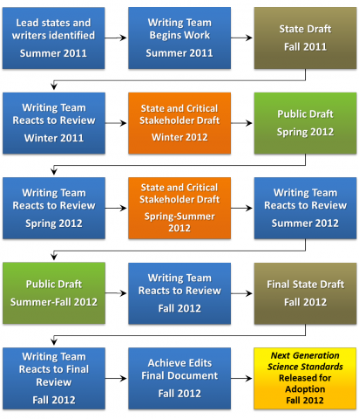
NGSS Timeline

Slide 6
State Standards for Social Studies: The College Career and Civic Life (C3)
Kentucky is working within the CCSSO Social Studies Assessment, Curriculum, and Instruction Project to develop new social studies standards that:
Include connections to the Common Core English/Language Arts standards in history/social studies.
Involve 20 state agencies working collaboratively with 15 professional organizations, teachers and academic writers
Notes:
As part of the external funding, we have begun to work on instructional and assessment exemplars across the social studies curriculum in civics, economics, geography and history.
By taking on the assessment and instructional challenges that come with new standards, we hope to portray a complete picture of what we think social studies should look like in the 21st Century classroom.
These exemplars are intentionally connected to the Common Core English Language Arts standards and will be poised to become national examples for embedding the literacy standards within the unique approaches of the social studies.
SSACI has received grants from the Library of Congress, Discovery, National Geographic and the Spencer Foundation, which are being utilized to bring an even bigger collaborative to bear on the issues that face social studies educators.

Slide 7
The College Career and Civic Life (C3) Structure (draft)
Draft version is arranged grade bands (K-2, 3-5, 6-8 and 9-12)
Organized around Disciplinary Core Ideas
  Civics
  Economics
  Geography
  History

Slide 8
The College Career and Civic Life (C3) Social Studies Timeline
October 2012 - Complete draft
November 2012 - Public release at the National Council for the Social Studies Conference
A public review of the standards will follow the anticipated November release date

